Slide 1


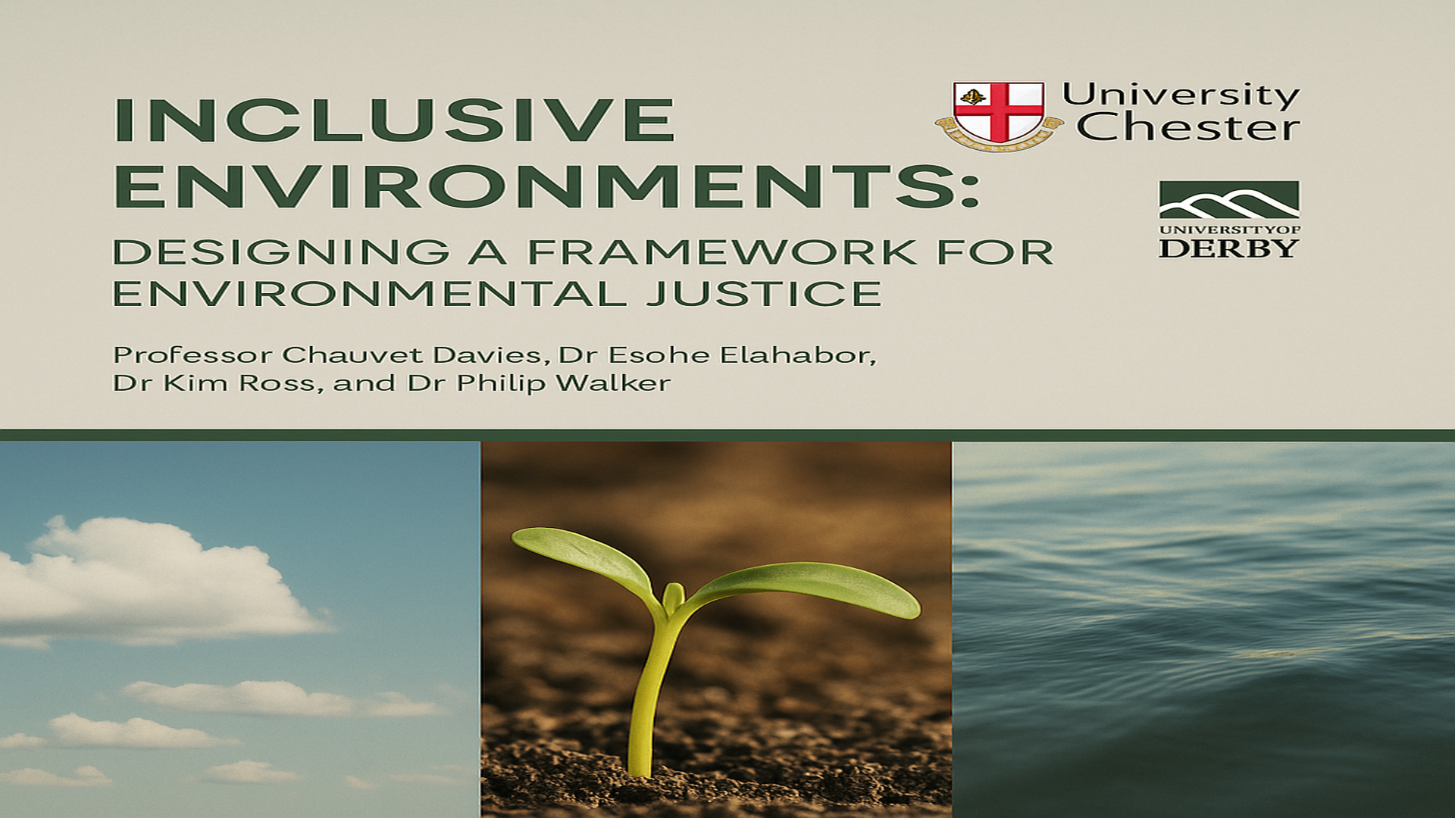
Nothing about us without us: developing a framework for inclusive environmental justice
Professor Chantal Davies

Slide 2
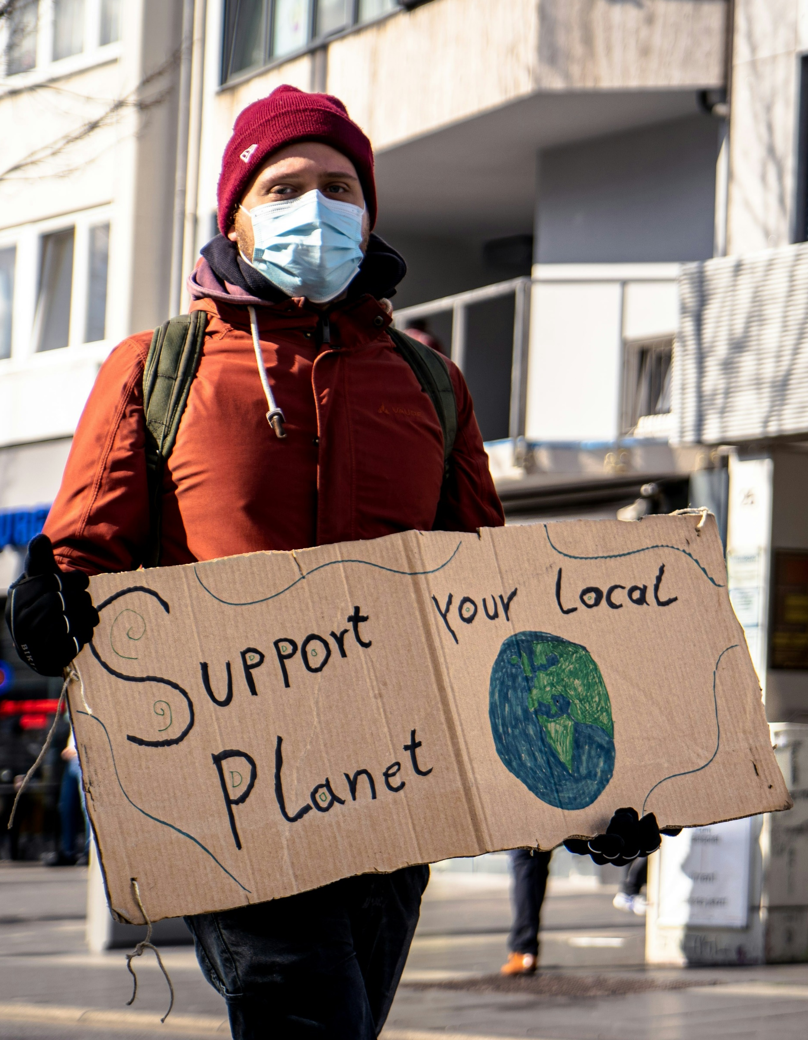
Exploring the concepts

Slide 3

Over to you…

Slide 4
From Sustainable Development to the SDGs: a brief history
Notes:
Evolution of Sustainable Development and Global Milestones

Slide 5

Evolution of Sustainable Development and Global Milestones
Origins and Definition
  The Brundtland Report (1987) defined sustainable development focusing on present and future needs balance.
Key International Summits
  Earth Summit (1992) introduced biodiversity and climate change conventions embedding sustainability globally.
Sustainable Development Goals
  SDGs adopted in 2015 consolidated goals addressing prosperity, people, and planet for global commitment.

Slide 6
Sustainable Development and Equality

Slide 7

Linking Environmental Justice, Inequality, and Sustainability
Environmental Justice and Marginalised Communities
  Environmental justice ensures policies do not unfairly burden marginalised groups, promoting equity in benefits and responsibilities.
Inequality and Environmental Degradation
  Greater inequality links to more environmental harm, while equitable societies maintain better environmental quality.
Holistic Approach for Sustainability
  Sustainability requires integrating social, economic, and environmental goals to ensure inclusive and effective progress.

Slide 8
What is environmental justice?
Notes:
Linking Environmental Justice, Inequality, and Sustainability

Slide 9

Defining Environmental Justice
Origins: Emerged from the US civil rights movement in the 1980s as a response to environmental inequalities and the disproportionate impacts on poor and minority ethnic communities, alongside exclusion from decision making (Schlosberg, 2007).
Core concepts (basic dual framework):
  Distributive justice - equitable distribution of environmental risks and benefits (Martin et al., 2020).
  Procedural justice - fair and meaningful participation in environmental decision making.
Extended framing: Often described as ‘three concepts of justice’ - distributive, procedural, and recognition (Walker, 2012).

Slide 10

Examples of environmental inequalities in the UK
Air pollution in London (minority ethnic and deprived communities more likely to live in the most polluted areas (London.Gov, 2023)
Access to green space is unequal by income and ethnicity (Friends of the Earth, 2020)
Flood risk and social vulnerability linked (Environment Agency, 2022; Environmental Audit Committee, 2025)

Slide 11

Introducing the Inclusive Environments Research and Framework

Slide 12
INCLUSIVE ENVIRONMENTS: THE RESEARCH
Why?
Sustainable and Inclusive Growth Commission Report 2022 recommendations
Embedded environmental inequalities
Where?
Cheshire and Warrington Subregion
Who for?
Communities
Public sector organisations
Private sector organisations
Who with?
Marginalised community voices
Public and private sector decision makers
UK and beyond

Slide 13
RESEARCH FINDINGS
Challenges
Impacts on Marginalised Communities
Environmental sustainability difficult to define clearly
Limited media coverage and public awareness around local environmental challenges
Environmental inequalities difficult to define clearly
Greater exposure to environmental risks
Barriers to sustainable living (e.g. cost, access)
What’s Needed
Localised, community-led solutions
Treat communities as partners
Invest in education, access & resilience
Align sustainability with social equity

Slide 14

Inclusive Environments: core recommendations
Development of a community engagement hub to help facilitate better public/private sector engagement with community voices
Development of an accessible and interactive environmental impacts map to help raise awareness of environmental justice and related issues.
Use of findings to inform wider national policy.
Development of a range of resources that public and private sector organisations can use to help embed co-production in environmental decision making.

Slide 15
Inclusive Environments Framework: overriding purpose
To centre communities in providing expertise on environmental impacts and suggesting just solutions.
To ensure that environmental sustainability decisions and policy do not exacerbate existing inequalities.

Slide 16
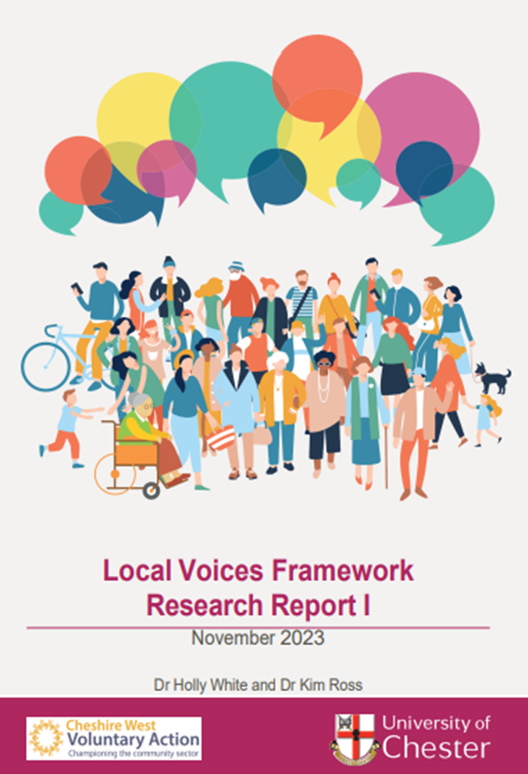
Underpinned by Principles of Co-production (White & Ross, 2023)
Embed co-production – Co-production should be embedded from the beginning to the end of the project when possible.
Plan appropriate infrastructure and support – coproduction needs to be rooted in the structure of organisations.
Promote equality, diversity and inclusion – coproduction should be an accessible opportunity, where difference between people is valued and respected, and practices are inclusive.
Build empowering and equal relationships – coproduction should be underpinned by trusting, respectful, and empowering relationships.
Foster open and transparent communication – coproduction should be based on honesty and transparency.
Provide ongoing support – support should be made available for those with lived experience and other stakeholders who are involved with coproduction.
Learn, reflect, adapt with partners – coproduction should be an ongoing and collaborative learning process.
Share a vision of meaningful change – coproduction should be recognised as a social movement

Slide 17
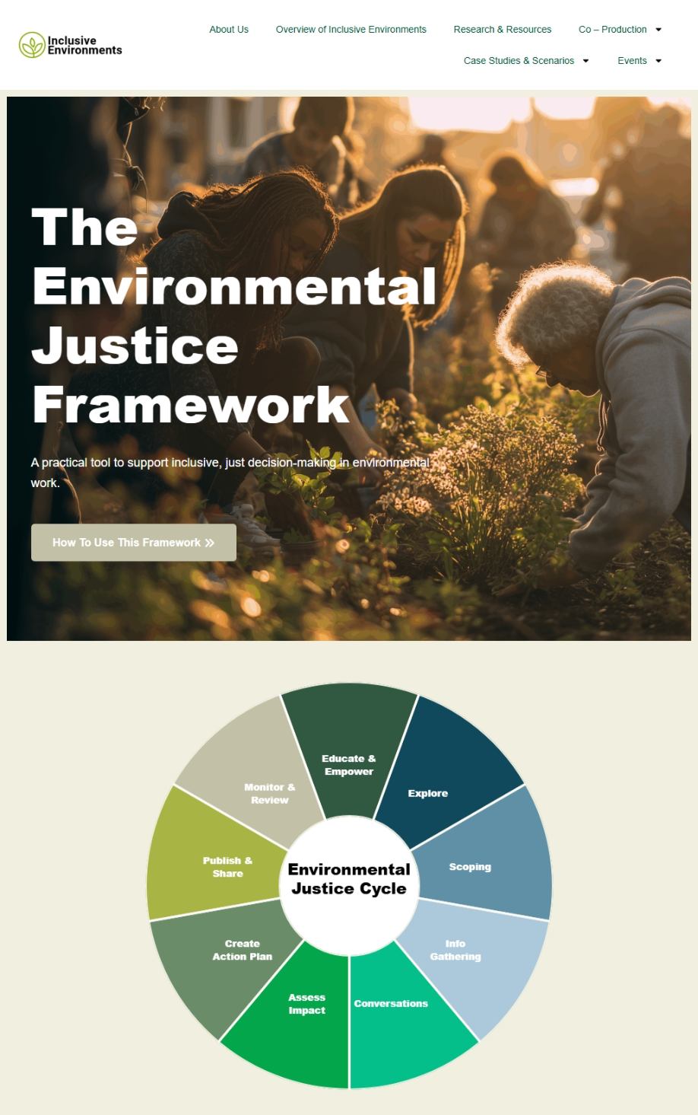
THE INCLUSIVE ENVIRONMENTS WEBSITE
www.inclusive-environments.org

Slide 18
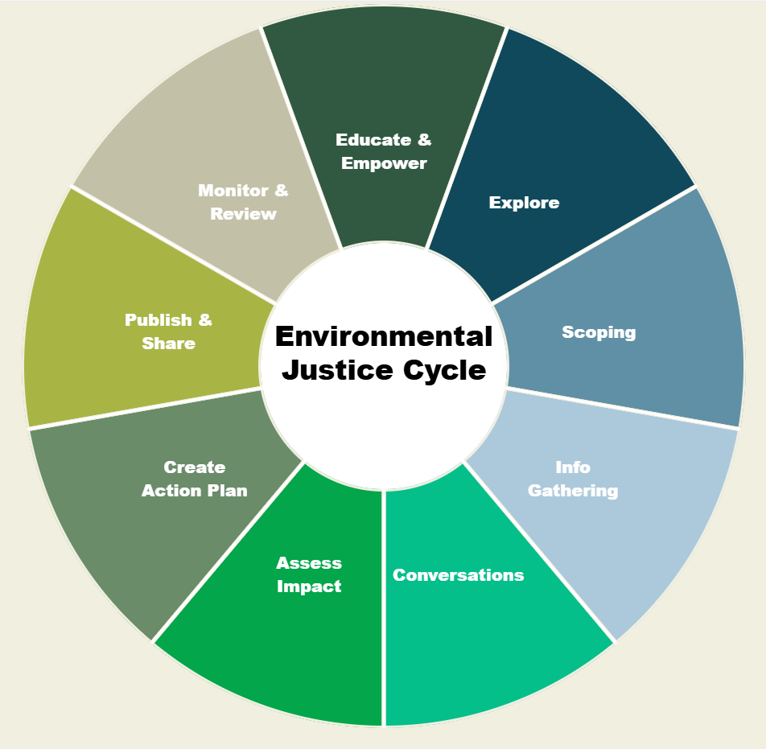
Introducing the Inclusive Environments Framework and the Environmental Justice Cycle

Slide 19
The Lived Experience Lead
Role of a Lived Experience Lead: A person with lived experience of social marginalisation and co-production, recommended to co-lead all stages of the Environmental Justice Framework for meaningful community involvement.
Value in Co-Production: Lived Experience Leads bring unique insights and practical knowledge, enhancing co-production efforts across public, private, and community sectors.
Support and Resources: Organisations like Cheshire West Voluntary Action offer access to Lived Experience Leads through initiatives like the Local Voices Network.

Slide 20
Educate & Empower
Community Collaboration: Encourage organisations to partner with communities to build shared understanding of environmental sustainability, especially engaging those with lived experience of social vulnerabilities.
Mutual Learning & Trust: Promote two-way knowledge exchange to foster trust, support fairer solutions, and enable transparent, just environmental decision-making.
Engagement Activities: Use tools like workshops, school partnerships, community events, and social media to spread awareness and drive participation.

Slide 21
Explore
Foster Inclusive Collaboration: Deepen partnerships with communities (especially marginalised groups) to understand environmental impacts and co-create sustainability solutions.
Centre Community Voices: Use inclusive engagement methods (e.g. workshops, liaison groups, online hubs) to ensure community perspectives shape environmental decision-making.
Adopt Co-Production & Adaptation: Build on existing networks and apply co-production principles to develop responsive initiatives, with ongoing review and community input.

Slide 22
Scoping
Early Impact Assessment: Scoping is an initial review to evaluate the potential effects (positive or negative) of a proposed environmental sustainability measure.
Focus on Equity: It ensures that the impact on marginalised communities is considered from the outset.
Decision-Making Tool: Especially useful when multiple options are on the table, helping organisations choose the most effective and equitable path forward.

Slide 23
Information Gathering
Purpose of Information Gathering: Conducted when initial scoping suggests potential impacts (positive or negative) on different community groups.
Focus on Inclusion: Prioritises understanding effects on marginalised or underrepresented communities.
Supports Impact Assessment: Provides essential insights to evaluate how proposed sustainability measures affect people.

Slide 24
Conversations
Inclusive Engagement: Conversations are led by a Lived Experience Lead or organisation to involve marginalised communities in environmental sustainability planning.
Community-Centered Approach: Focuses on listening to those most affected, especially underrepresented voices.
Informed Decision-Making: Ensures real-world impacts are understood and no one is left behind in sustainability efforts.

Slide 25
Assess Impact
Collaborative Evaluation: Involves joint assessment between the Lived Experience Lead and the organisation.
Impact Focus: Determines whether the sustainability measure affects marginalised communities positively, negatively, or neutrally.
Informed Decision-Making: Builds on prior research and conversations to guide inclusive and equitable outcomes.

Slide 26
Action Plan
Collaborative Planning: The Lived Experience Lead and the organisation co-develop a clear and inclusive plan.
Accountability & Clarity: The plan outlines specific steps to implement the proposed environmental change.
Informed by Impact Assessment: Builds on insights from evaluating effects on marginalised communities.

Slide 27
Publish & Share
Final Approval & Communication: Senior management approves the sustainability measure, followed by transparent communication with affected communities about its impacts.
Public Sharing & Trust Building: The measure and its development process are shared publicly to foster trust, accountability, and promote best practices.
Reflection & Documentation: Lessons learned are reviewed and all actions are recorded in the Environmental Justice Template for future reference.

Slide 28
Monitor & Review
Ensures Ongoing Effectiveness: Continuously evaluates the relevance and impact of sustainability measures.
Adapts to Change: Monitors evolving environmental and social impacts over time.
Promotes Continuous Improvement: Emphasizes that monitoring is an ongoing process, not a final step.

Slide 29
Over to you…

Slide 30
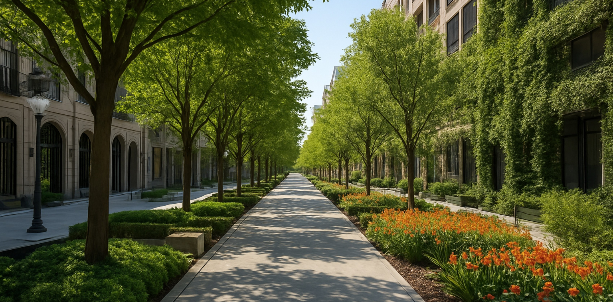
GREEN STREETS FOR ALL HYPOTHETICAL SCENARIO

Slide 31
Hypothetical Scenario 1: Green Streets for All
The local council of a mid-sized town is planning to implement a “Green Streets” initiative. The project involves converting several car-dominated streets into pedestrian-friendly green corridors with trees, seating, bike lanes, and community gardens. The goal is to reduce air pollution, encourage active travel, and improve public health.
The proposed streets run through a diverse, low-income neighbourhood with a high proportion of elderly residents, disabled individuals, and ethnic minority communities.

Slide 32

Hypothetical Scenario 1: Green Streets for All
The local council of a mid-sized town is planning to implement a “Green Streets” initiative. The project involves converting several car-dominated streets into pedestrian-friendly green corridors with trees, seating, bike lanes, and community gardens. The goal is to reduce air pollution, encourage active travel, and improve public health.
The proposed streets run through a diverse, low-income neighbourhood with a high proportion of elderly residents, disabled individuals, and ethnic minority communities.
HINT: Concerns have been raised about:
Reduced car access for those with mobility issues
Gentrification and rising rents
Lack of consultation with local residents

Slide 33
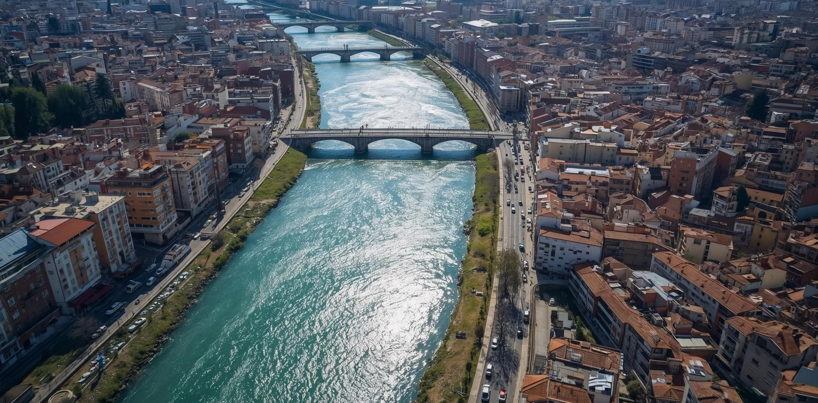
RESILIENT RIVERSIDE HYPOTHETICAL SCENARIO

Slide 34
Hypothetical Scenario 2: Resilient Riverside
A city council is launching the “Resilient Riverside” project to address increasing flood risks along a river that runs through a densely populated urban area. The plan includes constructing new flood barriers, creating green buffer zones, relocating some homes and businesses from high-risk zones.
The area includes:
A large population of low-income renters
Several small, family-run businesses
A long-established immigrant community
A public housing estate with limited mobility access

Slide 35
Hypothetical Scenario 2: Resilient Riverside
HINT: Concerns raised include:
Displacement without adequate compensation
Loss of cultural and community spaces
Lack of accessible information about the project
Fear of “green gentrification” pricing out current residents
A city council is launching the “Resilient Riverside” project to address increasing flood risks along a river that runs through a densely populated urban area. The plan includes constructing new flood barriers, creating green buffer zones, relocating some homes and businesses from high-risk zones.
The area includes:
A large population of low-income renters
Several small, family-run businesses
A long-established immigrant community
A public housing estate with limited mobility access

Slide 36

What next?
The Inclusive Environments Framework and Environmental Justice Cycle in practice
Sharing of Inclusive Environments Framework
Case studies
Notes:
CD

Slide 37

Get in touch: chantal.davies@chester.ac.uk

Slide 38
Useful links and contact
Inclusive Environments Website
Sustainable and Inclusive Growth Commission
Local Voices Framework
Professor Chantal Davies (Chantal.davies@chester.ac.uk)
Dr Eghosa Ekhator (E.Ekhator@derby.ac.uk)
Dr Kim Ross (kim.ross@chester.ac.uk)
Dr Holly White (h.white@chester.ac.uk)

